Slide 1
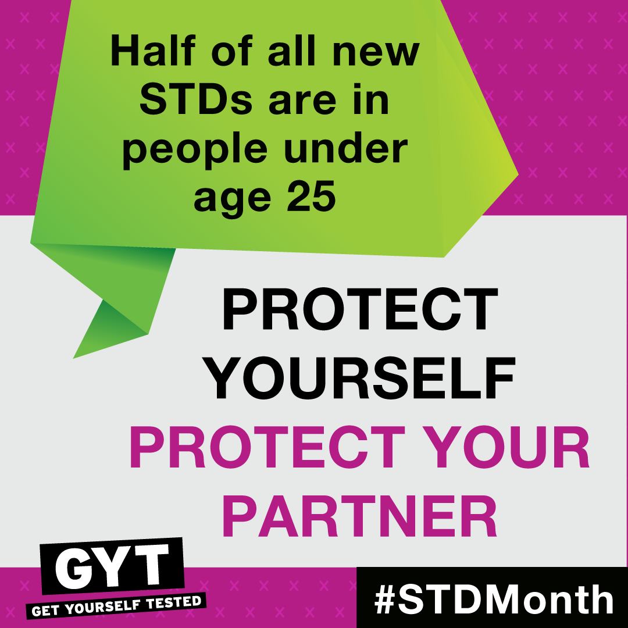
SEXUALLY TRANSMITTED DISEASES IN TEENS
Student’s Name
Institutional Affiliations

Slide 2

Overview of the Risk Factors
Sexually transmitted diseases are prevalent in teenagers because the age group is sexually active.
Teenagers are psychologically vulnerable and sexually active.
Sexually transmitted diseases that face this age group include syphilis, gonorrhea, HIV and AIDs, Chamydia and genital herps
Sexually transmitted illnesses in teens are prevalent and research shows that almost have of teens will have STDs by age 24.
Curbing the problem in teens is not easy due to the adventurous nature of people in teenage and young adulthood age group
Notes:
Having multiple sexual partners is regarded as the most significant risk factor for STDs in teens.
Desire to belong to particular peer groups is another risk factor.
Freedom from parents with the attainment of adulthood age encourages risky behavior in tens too.

Slide 3
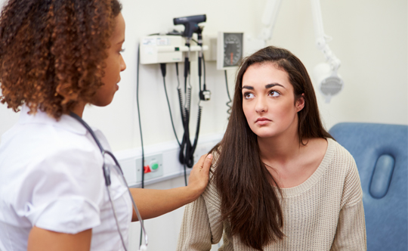
Contributing factors
The feeling of adulthood that brings about the urge to experiment sexual intercourses.
Peer pressure for most teenagers who have already had sexual partners.
Having unprotected sex (Do you use condoms? Have tests with a sexual partner before tests? Do you have multiple sex partners?).
Not taking tests before engaging is sex
Vulnerability of teenagers who are desperate to find belonging in certain peer groups
Notes:
Sexually transmitted diseases in teenagers are contributed by factors such as peer pressure and desire to find belongingness in particular group settings (Alimoradi, 2017). Most teenagers are pushed to having unprotected sex by those around them. The vulnerability of teenagers as a result of desire to be accepted in peer groups in social settings such as schools, teenagers and home also contribute to STDs in teens.
…. Share any other factors that you think contribute to STDs in young adults and teens.

Slide 4
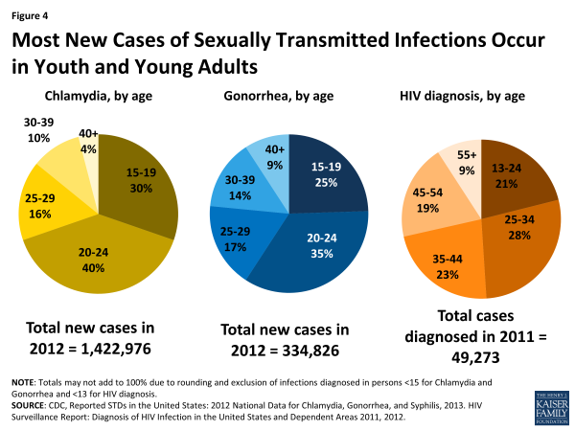
Prevalence of Sexually Transmitted Diseases in Teenagers
STDs are prevalent in teens within main cities and towns.
Prevalence of STDs is also high among people with little or no access to health education.
Communities struggling with poverty experience high prevalence of STDs in teens (Forhan, Gottlieb & Sternberg et al., 2009)
2 out of every 10 teenagers are reported to have STDs in major cities of the world according to the WHO report of 2018.
4
Notes:
Prevalence of sexually transmitted diseases in teens is always high in areas that have little or no access to health education (Forhan, Gottlieb & Sternberg et al., 2009). Also, exposure to digital media in urban areas drives teenagers to experiment with sexual matters leading to a rise of infection in youth. Communities that experience high levels of poverty have recorded high rates of prevalence due to the vulnerability that such conditions expose teenagers especially girls and young women to.

Slide 5

Prevalence of STDs in Teenagers in various Territories of the US in 2017
The most prevalent STDs in teenagers in the United Sates of America are:
Chlamydia
Secondary and Primary Syphilis
Gonorrhea
Herps simplex Virus, and
Human papilloma virus
Image on the right hand side represents Gonorrhea infection in parts of the US in 2017.
5
Notes:
Have you had any of your teenage friends talking about any of these diseases? Some have the diseases but do not know. Diagnosis is very important to know exactly what STD is ailing you. What do you think are some of the symptoms of these STDs? Boils and pus around the genitals? Swollen genitals? Boils that are very painful? Wounds on the tang? Rushes on the abdominal part, neck or mouth?

Slide 6


The role of a Health Care Practitioner/Advocate Regarding STDs in Teenagers
Educate -Through seminars, community youth meetings and preparation and circulation of appropriate educational materials that enlighten youth on the STDs.
Diagnose-Carry out tests on teens to determine the illness being suffered.
Refer-Refer youth to appropriate health facilities for diagnosis and treatment of the conditions being suffered. Also refer them to appropriate educational seminars about sexual life and STDs.
Treat- Prescribe and administer treatment and medication for various STDs.
Notes:
If you were a health care practitioner, what do you think your roles would be? ( Use this to create and interactive discussion between the presenter and the teenage audience).
A health advocate/practitioner plays 4 main important roles. Diagnosing, treating Referring and educating the society about the various diseases that affect people in the society, including STDs.

Slide 7
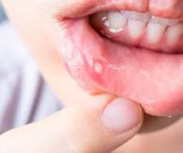
Ways of Identifying any STDs
To identify STDs, look out for the following general symptoms:
Sores and boils in private parts near genitals.
Burning sensation when passing urine.
Urinating blood.
Pains in the abdominal areas.
Sores on the tang and lips.
Pain in the genitals when having sexual intercourse.
Sensational itching in genitals.
Notes:
Various STDs manifest themselves in different ways But general symptoms of most STDs rage from pains, sores and boils in the genitals and mouth areas to physical manifestations through boils and rotting in the genitalia (Sexual Health of Adolescents and Young Adults in the United States, 2014).
Discussion question for the teens: Which symptoms have you seen either in your self or someone in your life?

Slide 8
Addressing the Issue
Keeping one sexual partner.
Testing for STIs before engaging in sex with a sexual partner to avoid being infected.
Visiting a heath facility for advice, diagnosis and treatment of STIs.
Attending teenage seminars about STDs and prevention of other diseases.
Avoiding rushing into relationships at a young age.

Slide 9
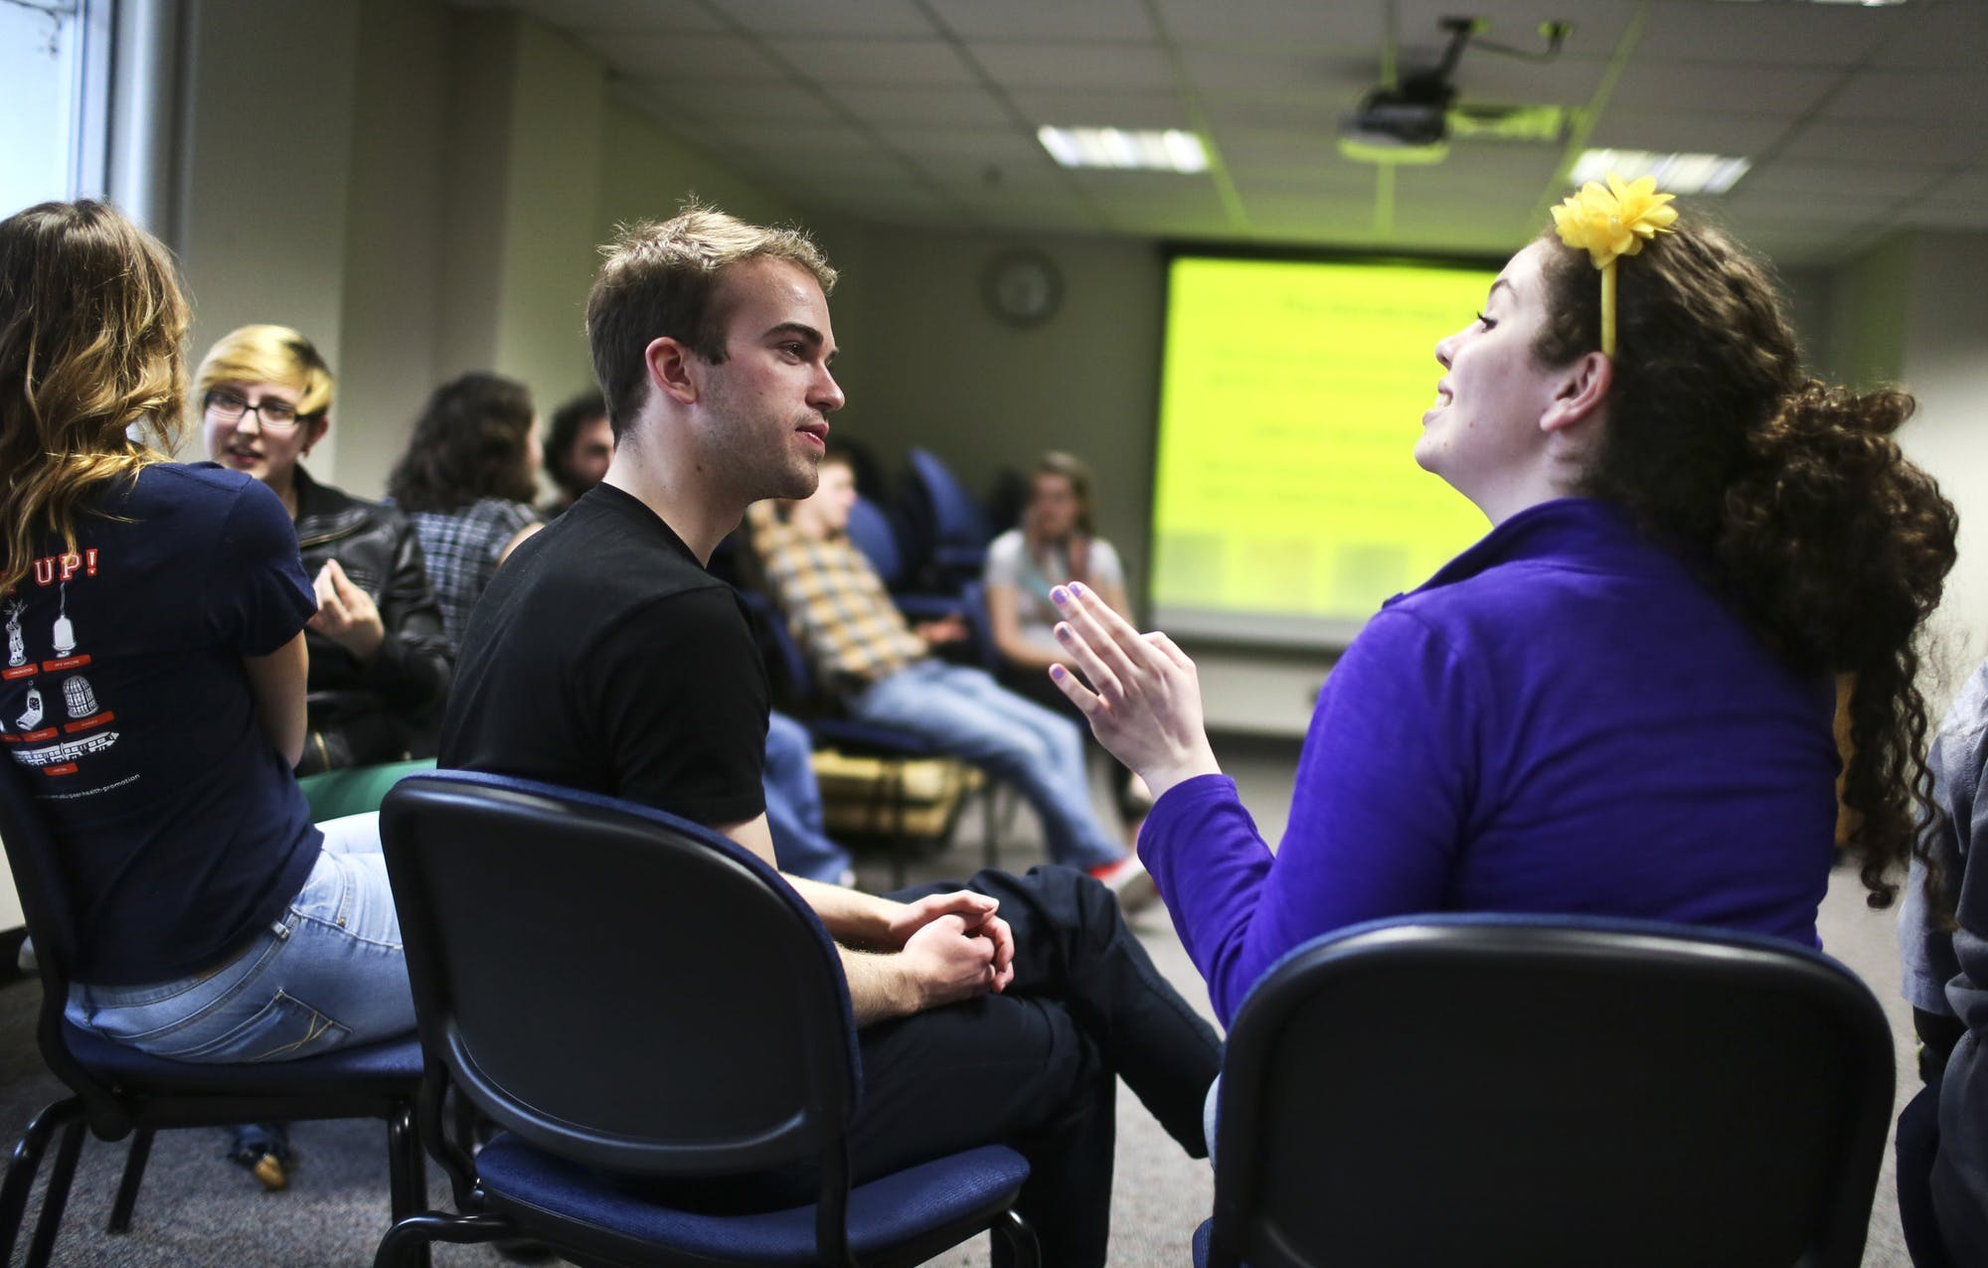
Activity for the Audience Interaction
This activities will involve discussions of the teenagers in groups of 6.
The group will be composed of equal gender representation meaning 3 males and 3 females. The interaction will last for at least 45 minutes
This activity will involve direct straight talk to each other about various symptoms of STDs and how best the teens can promote good health in their teenage years.
Every group will be required to note down at least five points on the best ways of addressing the risk factors that expose the teens to risky behavior that brings about STDs.
The teens will ask questions to each other and find responses through googling and also asking the presenter for clarification where necessary.
This activity will aim at creating a self education platform for the teens about STDs and how to promote health in their teenage eyers.

Slide 10
Help and Support Sources
Parents and other significant adults in a teen’s life.
Guardians.
Health facilities for diagnosis and treatment.
Teenage counsellors such as religious leaders.
Community Elders.
Health practitioners in hospitals and also within the community.
Various webpages with information on STDs.
Educational media programs such as TV shows about Teenage STDs and prevention and teen health in general.
Notes:
Teenagers have a lot of avenues where they can get help. Parents, health facilities, web pages with vast information on STDs and health counsellors in the society are all useful sources of support for teens regarding STDs. Teenagers can also get help or information about how to protect themselves from STDs from available educational materials such as health flyers from health seminars and TV shows with programs about STDs.

Slide 11
References
Sexual Health of Adolescents and Young Adults in the United States (2014). Retrieved from https://www.kff.org/womens-health-policy/fact-sheet/sexual-health-of-adolescents-and-young-adults-in-the-united-states/
Forhan SE, Gottlieb SL, Sternberg MR, et al. (2009). Prevalence of sexually transmitted infections among female adolescents aged 14 to 19 in the United States. Pediatrics; 124(6):1505–1512.
Alimoradi, Z. (2017). Contributing factors to high-risk sexual behaviors among Iranian adolescent girls: A systematic review. International journal of community based nursing and midwifery, 5(1), 2.

Slide 12





THANK YOU
Name
Phone
Email
Website

